Slide 1

Impact of Music on Mood
Team Name: Next Level Analytics
Team Members: Nicole Potyra, Mahalaxmi Kalappareddigari, Darlene Marchan, Neelu Nerella, Shreya Boyapati

Slide 2
Problem
Our project focuses around how different music affects the mood of different people.
We are aiming to find out which key characteristics can best determine whether or not a listener will experience a positive or negative mood in response to music.

Slide 3
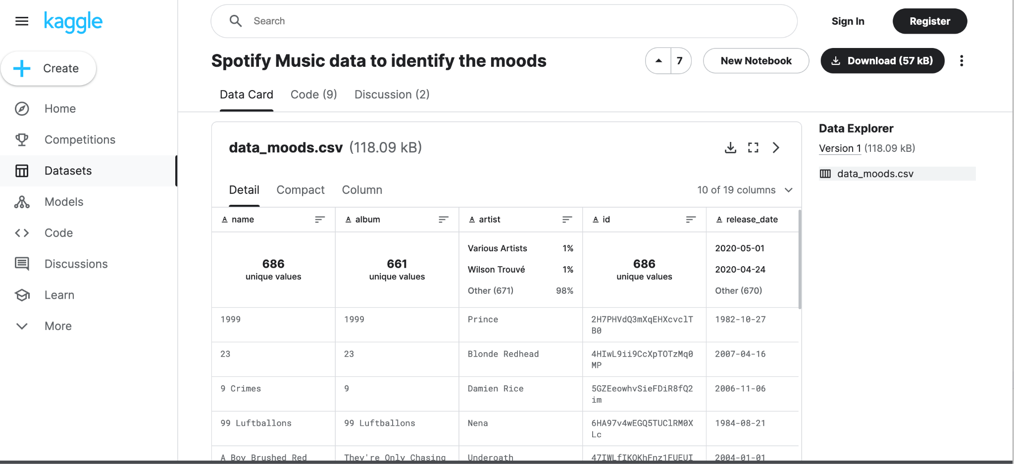
Data
Dataset Features: Name, Album, Artist, ID, Release Date, Popularity, Length, Danceability, Acousticness, Energy, Instrumentalness, Liveness, Valence, Loudness, Speechiness, Tempo, Key, Time Signature, and Mood

Slide 4
Solution
Sad music most popular with happy music as second
Happy music has a narrower range for tempo and time signature
Music with extreme time signature (1 bpm or 5 bpm) more popular than songs in 2-4 bpm range
Sad and calm music have slightly lower tempo than happy and energetic music
115 bpm vs 125 bpm – not as much as you’d expect!
Multiple influences on the mood of a song
Tempo
Key
Popularity
Time signature
Combination of factors rather than one single factor that determines the mood of music

Slide 5
What we did and how we did it
What we did?
As a group, we first considered our problem to see what factors in music contribute to how people perceive music positively or negatively. After, we considered how various musical features create different moods in music. We did this by finding a useful dataset with features that cause different moods. We found key trends of what musical features impact different moods through EDA, visualizations, and creating ML models.
How we did it?
First, we cleaned the data for any null values as well as columns that seemed rather subjective (e.x. “danceability”) in order to be able to form concrete conclusions from the data. We then performed statistical analysis for different quantitative variables within the data set. We began to see trends between mood and tempo/time signature and used EDA in the form of visualizations to explore this further.

Slide 6
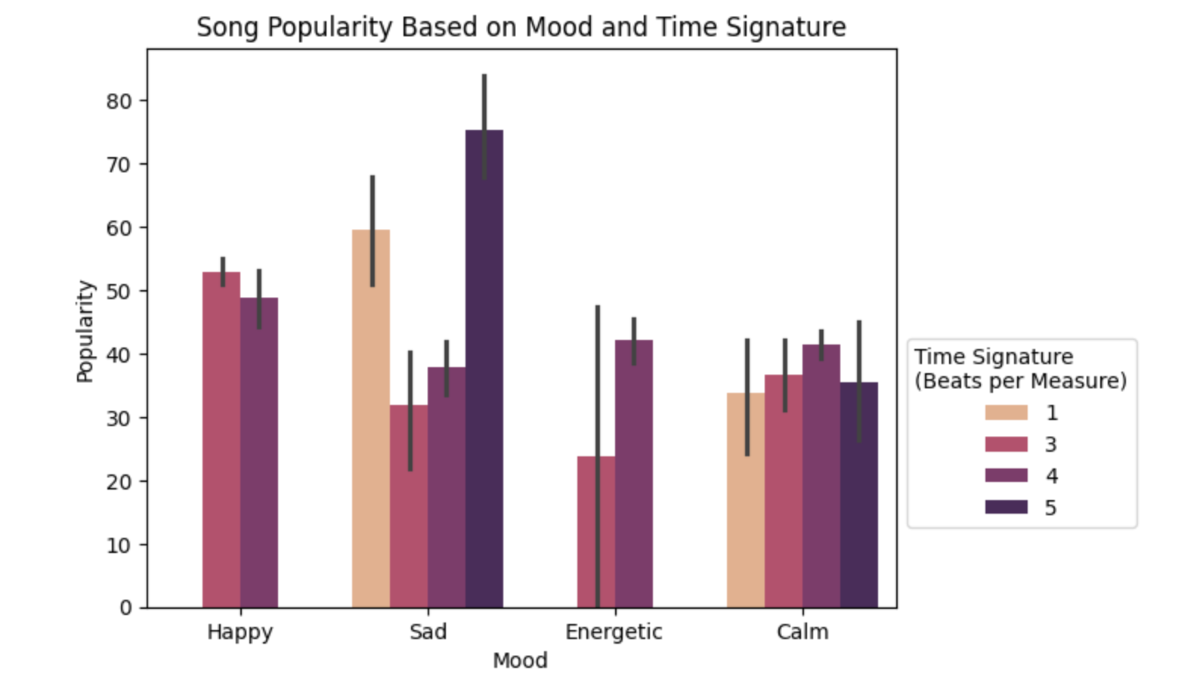
The first visualization we created is a barchart, plotting the popularity of different time signatures within different moods of music. Through this, we were able to see that happy and energetic music had a much narrower range of time signatures. This led us to the conclusion that time signature played a key role in an individual determining how a particular song made them feel.
Visualization 1

Slide 7
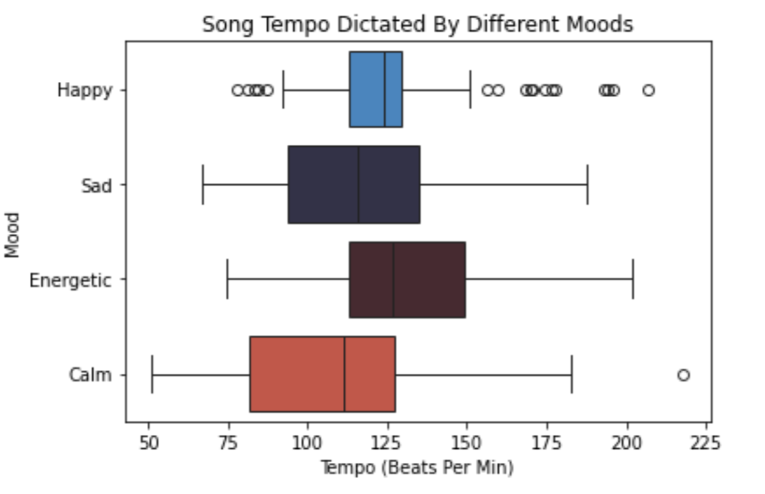
The second visualization we created is a boxplot which plots the song tempo for different moods of music. With this graph, we noticed that happy music had the narrowest range of song tempos specifically in the first and third quartiles unlike the other moods. There are also noticeable outliers in happy and calm music outside the five number summary range. Most importantly, happy and energetic music had higher tempos compared to sad and calm music. This can explain why songs characterized with a quicker beat tend to be energetic/happy than slow beat associated with sad/calm music.
Visualization 2

Slide 8
Evaluation
The solution worked because we were able to get valuable conclusions from this dataset and our exploration of the data. Our initial hypothesis was that the characteristics of a song, such as tempo and popularity, have an effect on the mood of the listeners, and we have determined that they in fact do.
In order to improve our results, we could run more models and visualizations on every characteristic in the dataset to figure out what specific characteristics themselves have the most impact on the mood of the listeners. We also could try merging another dataset with the current one we worked with as well to remove bias and improve the accuracies of these tests and models. Including other datasets also gives us more characteristics to work with that weren’t included in our dataset, as we had more subjective characteristics.

Slide 9
Main Project Takeaways 712
Songs that evoke feelings of happiness are often caused to make people feel good about themselves and to emphasize such feelings of joy are generally played at faster tempos in comparison to sad or calm music.
Then there are happy and sad moods which seemed to be most useful as they are opposites and can provide greater insights into an individual’s mood of a song.
After analyzing the various features that affect the moods that people feel about different music, our key takeaway was that varied time signature and tempo affected how a person perceived a song emotionally.

Slide 10
Thank You!
Questions?

